Slide 1
Data Analysis Using Hadoop
Module 4, Lesson 3:
Getting Started with HDInsight

Slide 2
Topics
Features the HDFS provides
HDInsight Clusters in Azure
What is Hbase?

Slide 3
Objectives
By the end of this lesson you should be able to:
Understand features of HDFS
Understand processing Big Data with HDInsight

Slide 4
HDFS Architecture
Architecture | Description
Block | Files in HDFS broken into fixed-size chunks (blocks)
Data Node | Node operating in slave mode
Name Node | Node operating in master mode
Secondary Name Node | Combines a snapshot of metadata and edit log into a new snapshot
Data Node
Name Node
Data Node
Data Node
Secondary
Name Node
Data Node
Master Node
Slave Nodes
Notes:
Notes:
Block default size is 64MB or 128 MB.
Blocks are stored as independent units.
Data Nodes store blocks of files.
Each block in stored on multiple nodes, with default 3 copies . Data Node doesn’t communicate with Name Node for operation.
Name Node stores all metadata information such as locations, ownership, locations of blocks, blocks names.
Secondary Name Node is NOT a failover Name Node. Periodically this node
Combines a snapshot of metadata and the edit log into a new snapshot.
Sends new snapshot to Name Node.
When Name Node is down, HDFS will be unavailable. The Name Node is a single point of failure (SPOF).

Slide 5
HDFS Architecture
High Availability HDFS: Avoid the Name Node SPOF.
Active Name Node
Standby Name Node
failover for Active Name Node
Data Node
Name Node
Active
Data Node
Name Node
Standby
Data Node
Data Node
Master Node
Slave Node
Notes:
Notes:
Active Name Node operates the same way as the Name node.
Standby Name Node maintains the same status as the Name Node.
The Standby Name Node will take over when the Active Name Node is down.
The name nodes must use highly available shared storage to share the edit log.
When a Standby Name Node comes up, it reads the shared edit log to synchronize its state with the Active Name Node.
The Standby Name node is then changed to the Active Name Node.
Data nodes must send block reports to both name nodes because the block mappings are stored in a name node’s memory.

Slide 6
HDFS Architecture: File Read Operation
1. Client request to read file
2. Returns name and location of first block in closest node
3. Client sequentially reads blocks from Data Node
Name Node
1
Master Node
Contains Blocks
B1, B2, B4
2
Data Node A
Contains Blocks
B1, B3, B2
Data Node B
3
Data Node C
…
Data Node D
Slave Node
B - Block
Client
Hadoop Cluster
Notes:
Notes:
Because there are three copies for each block, if the data node fails during operation, the next block in the list will be read.

Slide 7
HDFS Architecture: File Write Operation
1. Client request to write data.
2. Returns the name and list of Data Nodes for writing.
3. Client connects to the first Data Node A and sends data.
4. Block is stored and forwarded to the next Data Node in the pipeline. (Replication)
Name Node
1
Master Node
Contains Block
B1
Data Node A
2
4
Contains Block
B1
Data Node B
3
Data Node C
Contains Block
B1
Slave Node
B - Block
Client
Hadoop Cluster
Notes:
Notes:
The list of data nodes forms a pipeline, so there are three nodes in the pipeline. (We assume the replication number is 3)
If any data node fails while data is being written to it:
The current block on the good data nodes is given a new identity
The block on the failed data node will be deleted in pipeline.
A new pipeline is constructed from the good data node.

Slide 8
HDFS Architecture: File Permissions
Permissions for files and directories
Three types of permissions:
read(r)
write(w)
execute(e)
Apply on an owner, a group, or other
%hadoop fs –ls .
drwxr-xr-x – owner group 0 2016-04-02 22:10 /user/owner/test
-rw-rw-r-- owner group 110 2016-04-22 22:15 /user/owner/test/t.txt
Notes:
Notes:
Execute permission of file is ignored in HDFS.
Similar to POSIX model like Unix and Linux…
Each file and directory has an owner, a group, and a mode.
The mode is made up of:
Permissions for the user who is the owner
Permissions for users who are members of the group
Permission for users who are neither the owner nor members of the group (other)

Slide 9
HDFS Features on Azure
HDFS is the standard file system for Hadoop clusters on HDInsight.
High fault tolerance
HDFS compatibility
Optimized for distributed computing with high throughput
Read and write data stored in Blob Storage
Supports multiple Azure Blob Storage
Supports file system paths using URLs using wasb schema

Slide 10
Storing Data with HDInsight
Head Node
10
01
…
HDFS API
Azure
Blob storage
(default)
Container 1
(default file system)
Container 2
Container n
DFS
WASB(S)
10
01
Azure
Blob storage
(linked storage)
…
Worker Node
Container 1
Container 2
Container n
HDFS API
10
01
DFS
WASB(S)
Azure
Blob storage
(unlinked storage)
Container 1
(public blob)
Container 2
(public container)
Notes:
Notes:
The old asv:// syntax is not supported in HDInsight version 3.0 clusters.
HDInsight crrently only supports block blobs.
File paths can be referenced using WASB(S) or native syntax.
wasb://<containername>@<accountname>.blob.core.windows.net/<path>
hdfs://<namenodehost>/<path>
File paths are case-sensitive.
In HDInsight cluster, access is to the distributed file system that is locally attached to the compute nodes and Azure Blob storage.
Most HDFS commands (for example, ls, copyFromLocal and mkdir) still work as expected.
Native HDFS commands (for example, fschk and dfsadmin) show different behavior in Azure Blob storage.
Definitions:
Container – A grouping of multiple blobs. An account may have multiple containers.
Account name – All access is done through a storage account.
Blob – A file of any type and size. Files are stored in blobs.

Slide 11
HDInsight Cluster on Azure
HDInsight provides cluster types such as:
Hadoop
Hbase
Storm
Spark (Preview)
Customized clusters with script actions
Notes:
Notes:
Available on Windows and Linux.
HDInsight uses the Hortonworks Data Platform (HDP) Hadoop distribution. Provides a software framework designed to manage and analyze Big Data.
Cluster types:
Hadoop – HDFS and MapReduce programming (batch processing) model
Hbase – NoSQL database processing model
Storm – Large streams of data processing model
Spark – In-memory processing model
Script Actions are a way to customize Azure HDInsight clusters by specifying cluster configuration settings.
Each cluster type supports a different set of components. All 4 cluster types support Hive.

Slide 12
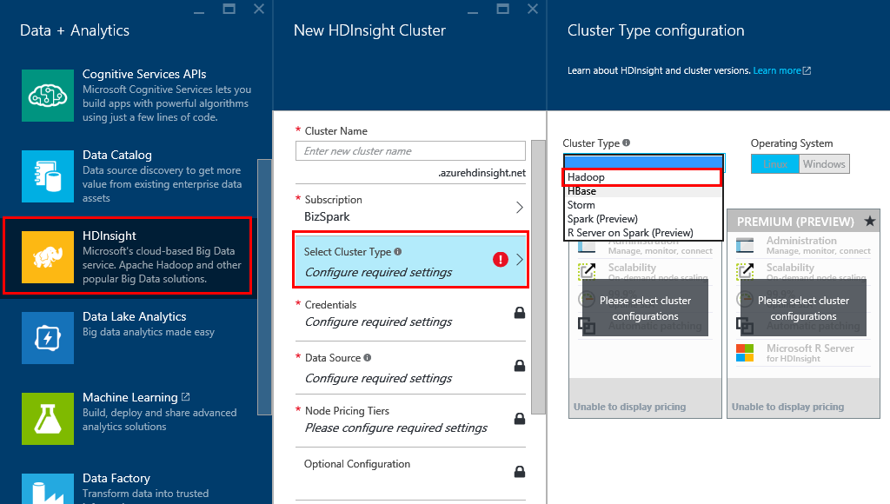
HDInsight Cluster on Azure
Notes:
Notes:
Cluster name - Used to identify a cluster.
Cluster type – Hadoop, Hbase, Storm, Spark
Operation system – Linux or Windows Server for HDInsight
Credentials - Create login and remote access credentials for the cluster. Configure two user accounts.
HTTP user. The default name is admin using the basic configuration on the Azure Portal.
SSH User: Used to connect to the cluster using SSH. There are two method for SSH Authentication:
Password
Public-key
Data source - Primary location for most data access, such as job input and log output
Provisioning normally takes 20 ~ 25 minutes. This will be done in Lab1.

Slide 13
What is Hbase?
Apache HBase is an open source, NoSQL database
Unstructured and semi-structured data in a schemaless database.
Data stored in rows of a table
HBase
0100
110110
HDFS
Notes:
Notes:
Hbase is a distributed column-oriented database built on top of HDFS.
HBase can be used as a key-value store
Facebook uses HBase for their messaging system
it is ideal for storing and managing Internet communications.
HBase is useful for capturing data that is collected incrementally from various sources.
Not a regular relational database like Oracle or MS SQL

Slide 14
Storing Data in HBase
Data stored as key-value pairs
Table schema arranges values into column families
Cells in table are versioned
Notes:
Notes:
HBase is useful to read/write random access to very large datasets.
It stores data in tables, consisting of key-value pairs.
The data is physically stored in files on HDFS.
Column families:
Data within a row is grouped by column family.
Column family schema is flexible.
Columns are row-specific.
Cell versioning:
Each versioned cell is indicated by a timestamp.
Doesn’t support features like SQL, transactions, or indexes.

Slide 15
HBase Operation
Main Commands
Command | Result
create | create a table. Like “create” in SQL
get | Read data in DB. Like “select” in SQL
put | Write data in DB. Like “update” or “insert” in SQL
scan | Obtain data from multiple rows in ad table. Like “select (no where condition)” in SQL
Notes:
Notes:
HBase can be managed using the Hbase C# API, and also queried by using Hive.

Slide 16
HBase Operation
Create a table:
Create ‘readings’, ‘sensor’, ‘reading’
readings
key | sensor | reading
Notes:
Notes:
To create a table, use the create statement
specify the table name followed by column groups
In the example, table name is ‘readings’, column groups are ‘sensor’ and ‘reading’.

Slide 17
HBase Operation
Insert values:
put ‘readings’, ‘1’, ‘sensor:id’, ‘Sensor1’
put ‘readings’, ‘1’, ‘reading:datetime’, ‘2015-01-01’
put ‘readings’, ‘1’, ‘reading:value’, ‘125.9’
readings
key | sensor | reading
 | id | datetime | value
1 | Sensor1 | 2015-01-01 | 125.9

Slide 18
HBase Operation
Insert values with new column:
put ‘readings’, ‘2’, ‘sensor:id’, ‘Sensor1’
put ‘readings’, ‘2’, ‘reading:datetime’, ‘2015-01-01’
put ‘readings’, ‘2’, ‘reading:value’, ‘152.3’
put ‘readings’, ‘2’, ‘sensor:location’,’Building 2’
readings
key | sensor |  | reading
 | id | location | datetime | value
1 | Sensor1 |  | 2015-01-01 | 125.9
2 | Sensor2 | Building 2 | 2015-01-01 | 152.3
Notes:
Notes:
In table, there is a location field in row 1.
It is possible to specify the key value, column family, and column name in row 2.
This generates a location column for that row.
It is possible to build this schema dynamically.

Slide 19
HBase Operation
Insert (update) value:
put ‘readings’, ‘2’, ‘reading:value’, ’157.6’
readings
key | sensor |  | reading
 | id | location | datetime | value
1 | Sensor1 |  | 2015-01-01 | 125.9
2 | Sensor2 | Building 2 | 2015-01-03 | 157.6
Notes:
Notes:
Use ‘put’ to insert a value into a cell.
If the cell doesn’t already exist, it is created
Otherwise, a new timestamped version of the data is added to the cell

Slide 20
HBase Operation
Get value from table:
get ‘readings’, ‘2’
readings
key | sensor |  | reading
 | id | location | datetime | value
1 | Sensor1 |  | 2015-01-01 | 125.9
2 | Sensor2 | Building 2 | 2015-01-03 | 157.6
Column | Cell
reading:value | timestamp=142379value=157.6
sensor:location | timestamp=142366value=Building 2
reading:datetime | timestamp=142363value=2015-01-03
reading:value | timestamp=142381value=157.6
output
Notes:
Notes:
Use ‘get’ to retrieve cells for the row.
By default, the most recent timestamped versions of each cell are returned.

Slide 21
HBase Operation
Get value from table
get ‘readings’, ‘2’, {COLUMN => [reading:value]}
readings
key | sensor |  | reading
 | id | location | datetime | value
1 | Sensor1 |  | 2015-01-01 | 125.9
2 | Sensor2 | Building 2 | 2015-01-03 | 157.6
Column | Cell
reading:value | timestamp=142379value=157.6
output
Notes:
Notes:
You can specify one or more COLUMN values to retrieve only those columns.

Slide 22
HBase Operation
Get everything from table with condition:
scan ‘readings’, {LIMIT => 1}
Row | Column + Cell
1 | column=sensor:id, timestamp=142356, value=Sensor1
1 | column=reading:datetime, timestamp=142357, value=2015-01-01
1 | column=reading:value, timestamp=142359, value=125.9
readings
key | sensor |  | reading
 | id | location | datetime | value
1 | Sensor1 |  | 2015-01-01 | 125.9
2 | Sensor2 | Building 2 | 2015-01-03 | 157.6
output
Notes:
Notes:
Use ‘scan’ to return multiple rows.
By default, the latest timestamped version of each cell is returned
You can also use LIMIT to scan the first N rows.

Slide 23
HBase Operation
Delete a value from a table:
delete ‘readings’, ‘2’, ‘sensor:location’
readings
key | sensor |  | reading
 | id | location | datetime | value
1 | Sensor1 |  | 2015-01-01 | 125.9
2 | Sensor2 | Building 2 | 2015-01-03 | 157.6
readings
key | sensor |  | reading
 | id | location | datetime | value
1 | Sensor1 |  | 2015-01-01 | 125.9
2 | Sensor2 |  | 2015-01-04 | 157.6
Before
After
Notes:
Notes:
Use ‘delete’ to remove a value from a cell
This overrides any previous timestamped value.

Slide 24
HBase Operation
Delete a row from a table:
deleteall ‘readings’, ‘1’
readings
key | sensor |  | reading
 | id | location | datetime | value
1 | Sensor1 |  | 2015-01-01 | 125.9
2 | Sensor2 | Building 2 | 2015-01-03 | 157.6
readings
key | sensor |  | reading
 | id | location | datetime | value
2 | Sensor2 | Building 2 | 2015-01-03 | 157.6
Before
After
Notes:
Notes:
Use ‘deleteall’ to delete all cells in a specified row.

Slide 25
HBase Operation
Delete the entire table:
disable ‘readings’
drop ‘readings’
Notes:
Notes:
To delete the entire table:
First disable it: No more queries should be able to use this table.
Second delete it permanently by dropping it: Use the ‘drop’ statement.

Slide 26
Summary
In this lesson, you have learned:
Some HDFS features
Provisioning HDInsight
What HBase is
How to use operations in HBase
Notes:
Notes:
The Module 4 Lesson 3 Lab should be completed at this time:
https://github.com/MSFTImagine/computerscience/tree/master/Complimentary%20Course%20Content/Module4/Labs

